Slide 1

MATH ROTATION IDEAS
The following slides are some templates for you to use when incorporating Ascend Math into your math rotations.
If you need more columns or rows, you can insert them by right clicking in the last row or column and then clicking insert row/column.
There are many images to choose from on the last slide for your stations. Simply copy the image you want and then paste it as many times as you need on the slide you are using. These images stand for your rotation activities. You can have these stand for whatever you want your students to do. Feel free to insert text boxes to add any information your students may need such as times, names, activities, etc.
Some ideas:
Ascend Math
Fact Practice/Flash Card Math (in Ascend)
Teacher Time/Table
Hands-on Activity
Tech Time
Workbook/Mathbook/Math Journal
Math Game
At Your Seat Work

Slide 2




MATH ROTATIONS
 | ROTATION 1 | ROTATION 2 | ROTATION 3 | ROTATION 4
GROUP 1
GROUP 2
GROUP 3
GROUP 4
COPY & PASTE GRAPHICS FROM LAST SLIDE AS NEEDED

Slide 3
MATH ROTATIONS
 | ROTATION 1 | ROTATION 2 | ROTATION 3
GROUP 1
GROUP 2
GROUP 3
COPY & PASTE GRAPHICS FROM LAST SLIDE AS NEEDED

Slide 4
MATH ROTATIONS
 | TYPE HERE | TYPE HERE | TYPE HERE | TYPE HERE
TYPE HERE
TYPE HERE
TYPE HERE
TYPE HERE
COPY & PASTE GRAPHICS FROM LAST SLIDE AS NEEDED

Slide 5
MATH ROTATIONS
 | TYPE HERE | TYPE HERE | TYPE HERE
TYPE HERE
TYPE HERE
TYPE HERE
COPY & PASTE GRAPHICS FROM LAST SLIDE AS NEEDED

Slide 6















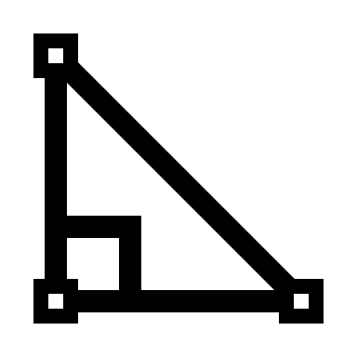
STATION IMAGES
COPY & PASTE GRAPHICS AS NEEDED

